Slide 1
Chapter 7
Exploring Microsoft Windows 7

Slide 2
Learning Objectives
Identify the parts of the Windows 7 desktop
Use common Windows elements
Navigate Windows
Work with the Recycle Bin
Get Help
Shut down Windows

Slide 3
Exploring the Windows 7 Desktop
Topics Covered:
  Starting Windows and Examining the Desktop
  Using the Mouse
  Exploring the Start Menu

Slide 4
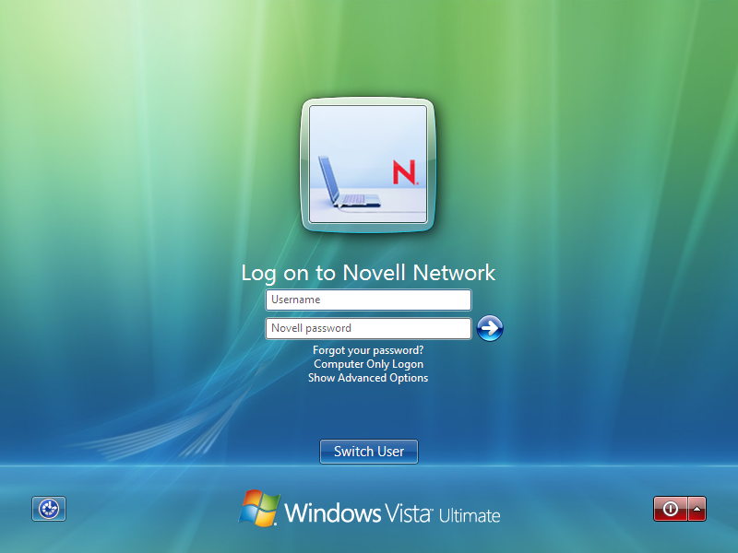
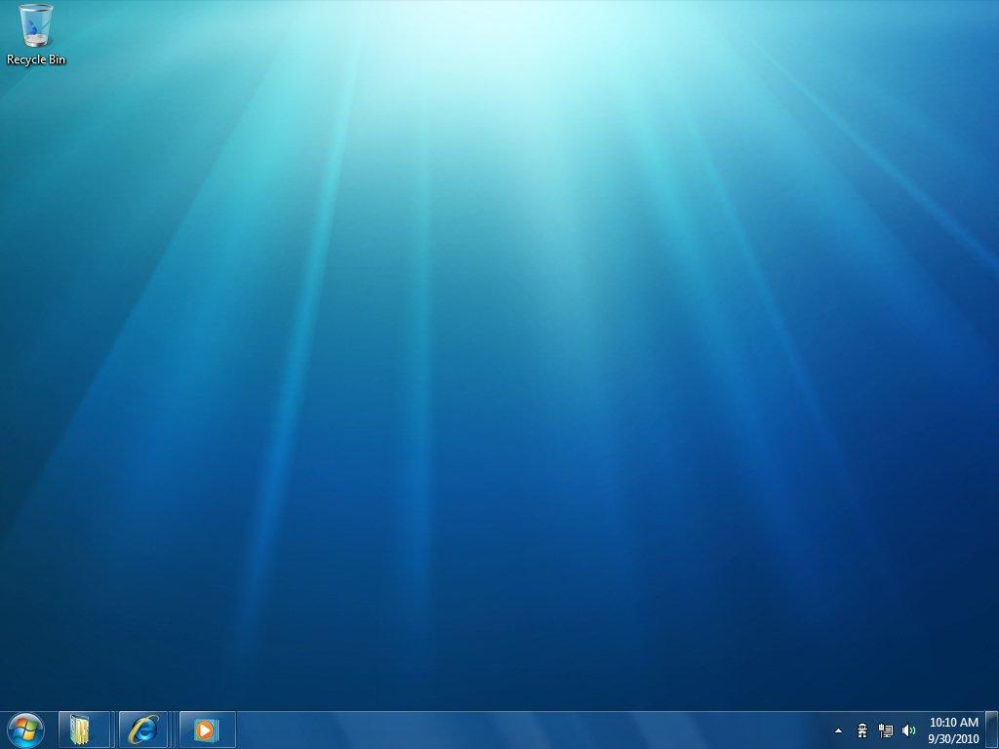
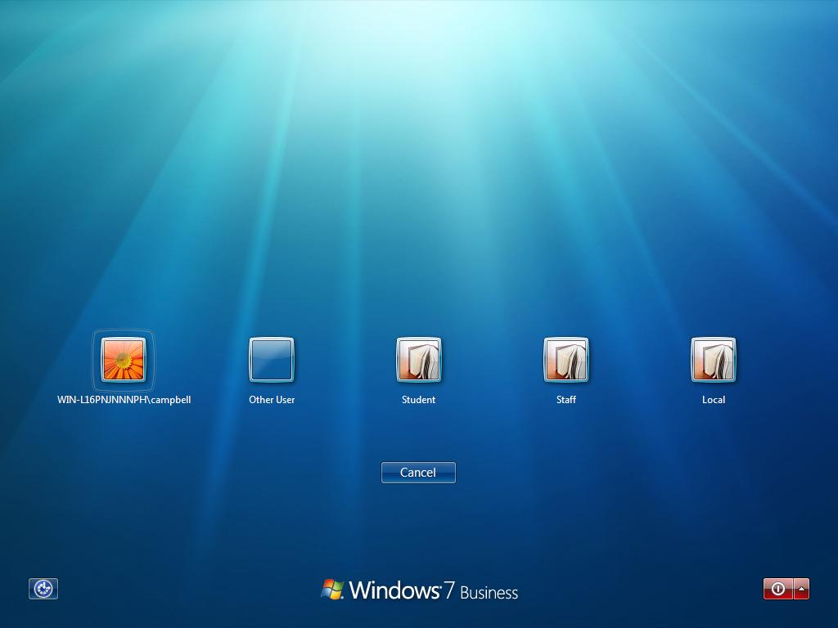
Starting Windows and Examining the Desktop
To start Windows, you simply turn your computer on.
One of three screens will appear
  Desktop
  User icons
  Classic login

Slide 5
Starting Windows and Examining the Desktop
The desktop is the whole workspace on the screen.
A desktop’s theme is a set of backgrounds, window colors, sounds, and screen savers.

Slide 6
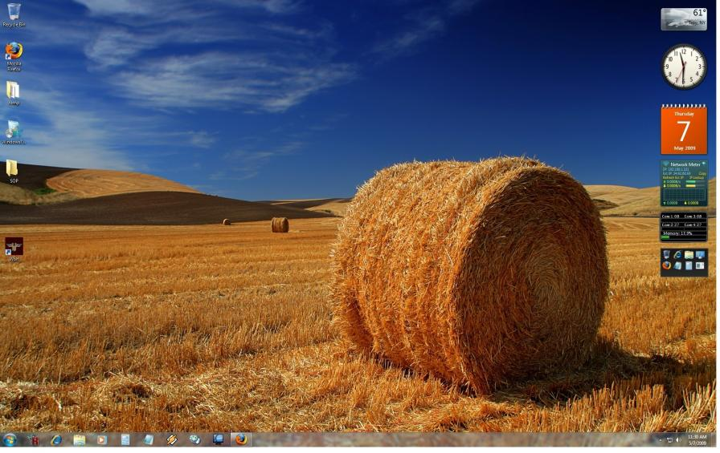
The Windows Desktop
Icons - is a small picture or symbol serving as a quick, intuitive representation of a software tool, function or a data file accessible on the system.
Gadgets - mini programs that offer information at a glance and provide easy access to frequently used tools.
Theme – a set of desktop backgrounds, window colors,
sounds, and screen savers.
Taskbar - horizontal bar at the bottom of the screen with buttons that provide quick access to common tools and running programs.
Notiﬁcation area - part of the taskbar that displays icons that provide information about the computer and programs that are running.
Button - graphical icon you click to start a program or perform a command.

Slide 7
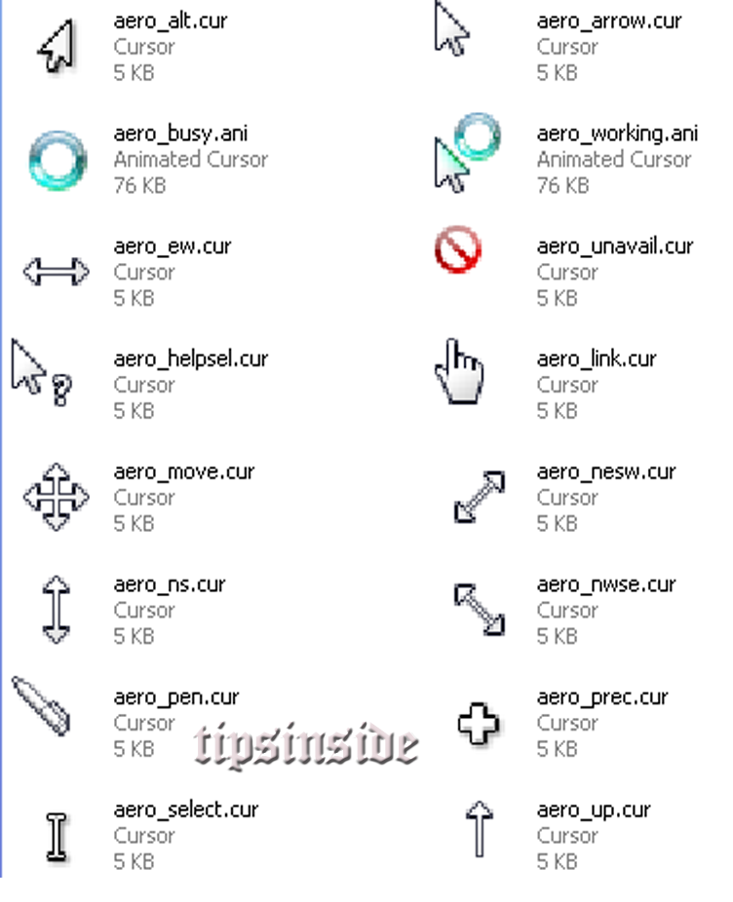
Pointer
The pointer is a small object that moves on the screen when you move your mouse.
Common pointer shapes

Slide 8
Using the Mouse
Point: Positioning the pointer directly on top of an item.
Click: Pressing the left mouse button and immediately releasing it.
Right-click: Clicking the right mouse button and immediately releasing it.
Double-click: Clicking the left mouse button twice in quick succession.
Drag: Positioning the pointeron top of an item, and then pressing and holding the left mouse button while moving the pointer.

Slide 9
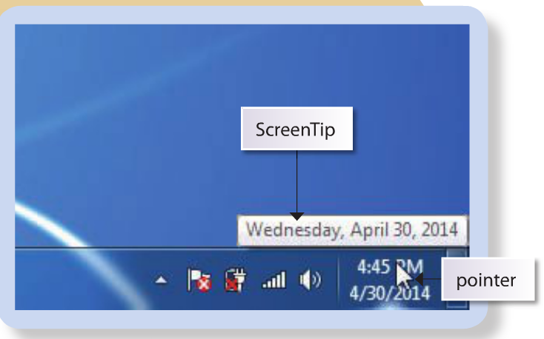
Screen Tip
When you want more information about an item on the desktop, you can point to that item to make a ScreenTip appear.

Slide 10
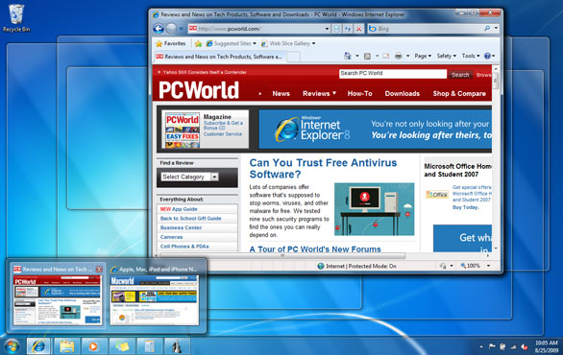
Aero Peak
You can use Aero Peek to quickly preview open windows without leaving your current window behind.
  Point to a taskbar button to see a thumbnail preview of that window,
  Point your mouse to that thumbnail to preview the window full-screen.
  If you decide you want to switch to the window you’re previewing, just click the thumbnail. It’s unbelievably useful.

Slide 11
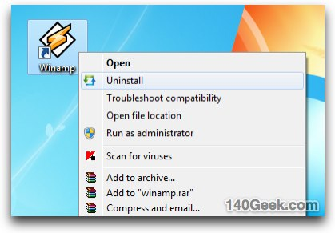
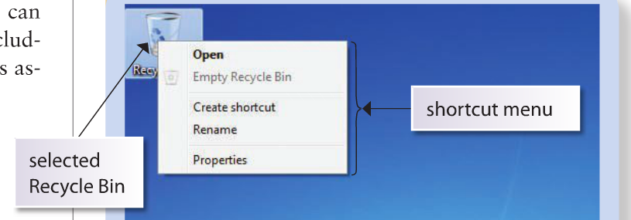
Shortcut Menues
A shortcut menu lists actions you can take with the item you right-clicked.
You can right-click practically anything on the desktop, including a blank area of the desktop, to view commands associated with that item.

Slide 12
Exploring the Start Menu
The Start menu provides access to programs, documents, and much more.
The Start menu is organized into two panes, or separate areas of a menu or window.

Slide 13
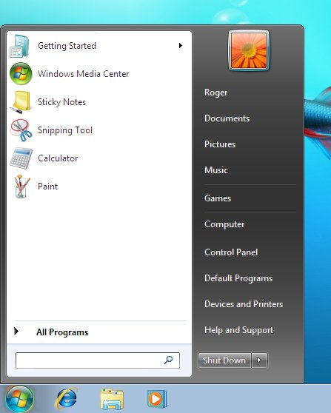
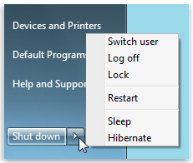
Exploring the Start Menu
Left Pane
Right Pane
Icon associated with your account
Your account name appears here
List of recently used programs.
Commands to access common locations on your computer
Commands to access tools on your computer
All Programs submenu
Buttons for logging off and shutting down your computer
Search Box

Slide 14
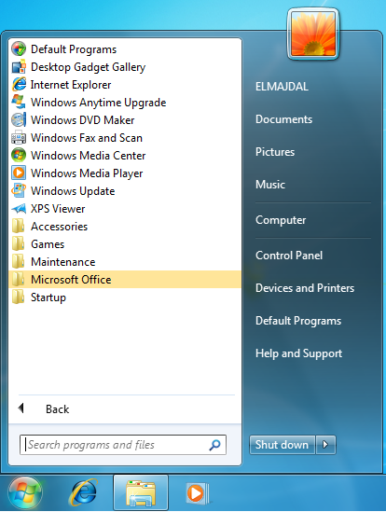
All Programs Submenu
Individual programs
Program submenus

Slide 15
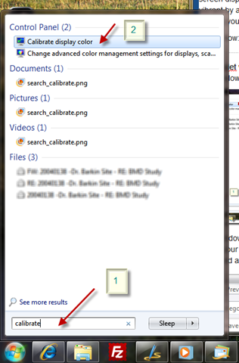
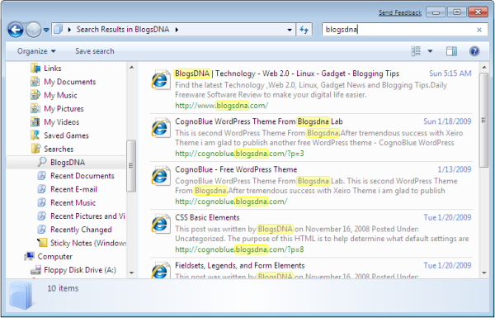
Search Box

Slide 16
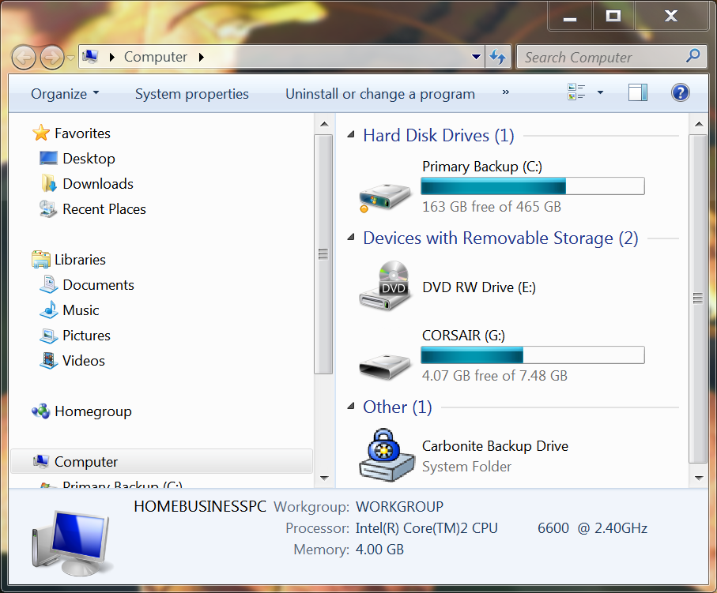
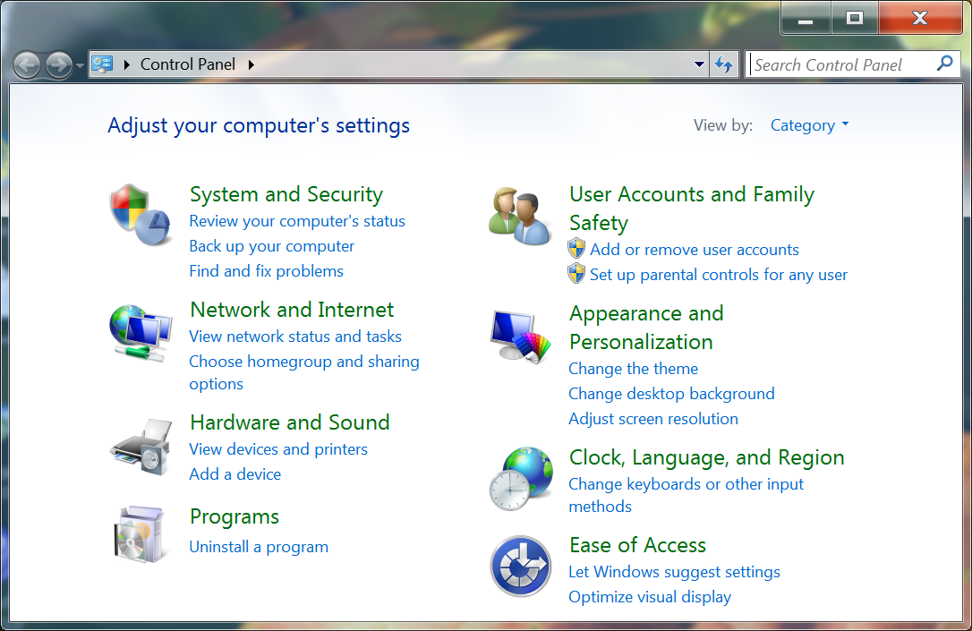
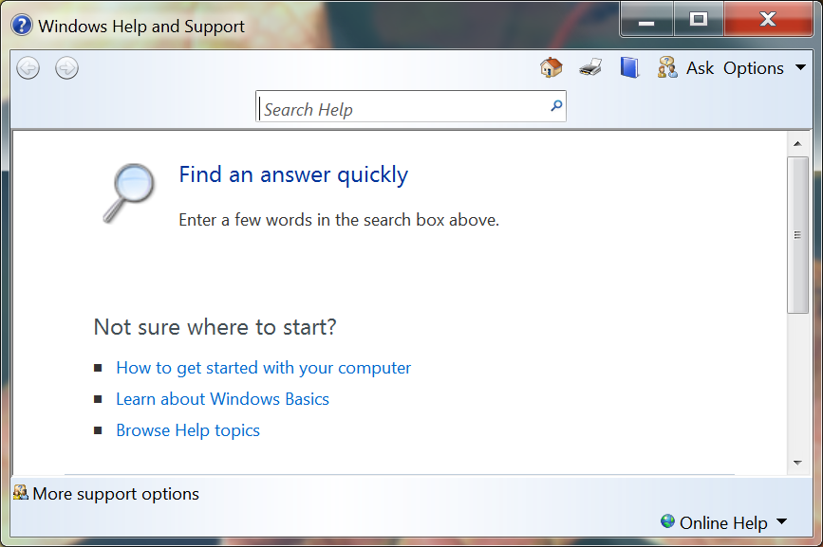
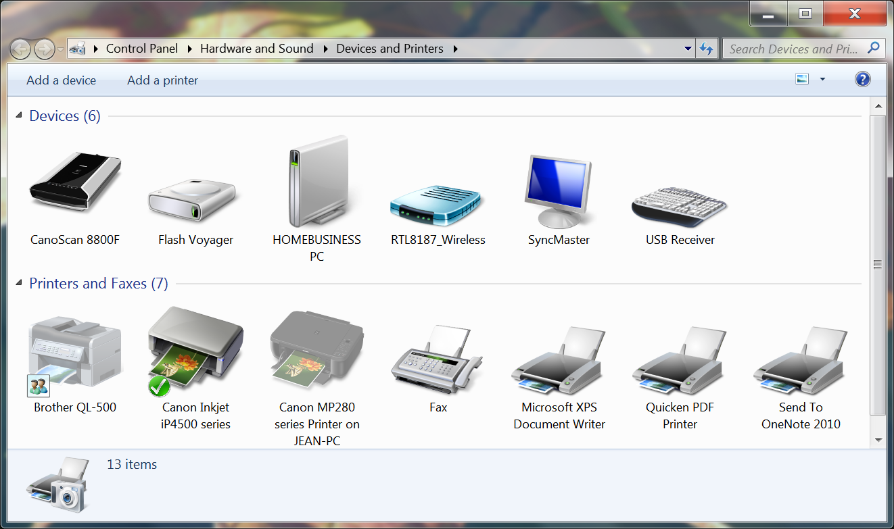
Exploring the Start Menu
The bottom of the right pane allows you to open windows that help you effectively work with Windows 7.
  Computer.
  Control Panel
  Devices and Printers
  Help and Support

Slide 17
Using Common Windows Elements
Two types of windows:
  Program windows
  Windows Explorer windows
Topics Covered:
  Resizing and Moving Windows
  Switching Between Open Windows

Slide 18
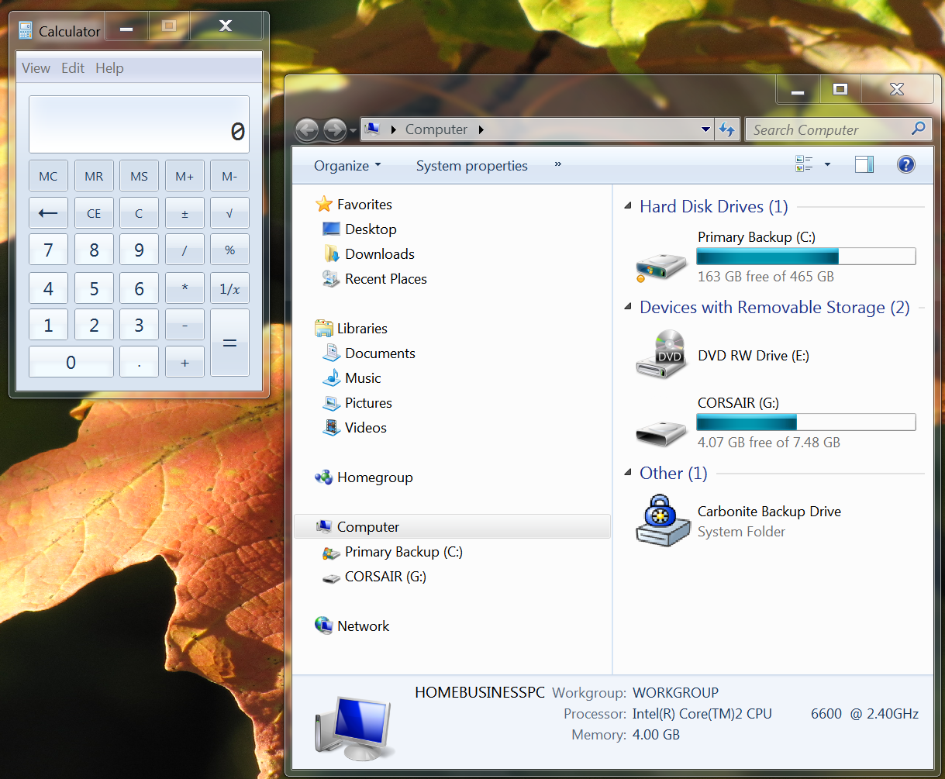
Common Window Elements
Title bar - a banner at the top of a window that displays the window title and contains the sizing buttons.
Window title - Identifies the program and document contained in the window.
Sizing buttons - Used to enlarge, shrink, or close a window.
Details pane/Status bar -Displays information or messages about the task you are performing or the selected item

Slide 19




Resizing and Moving Windows
After you open a window, you can manipulate it by changing its size and position.
In most windows, three sizing buttons appear on the right end of the title bar:
  Minimize button
  Maximize button
  Restore Down button
  Close button

Slide 20
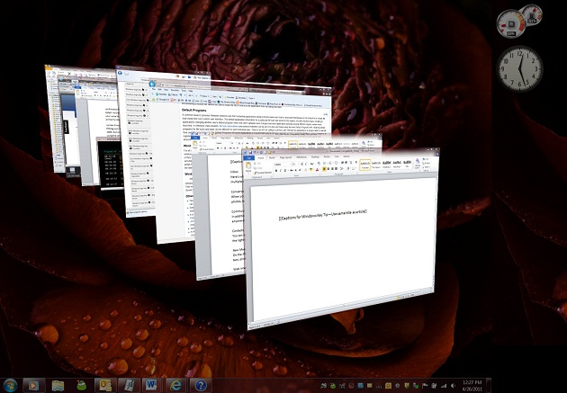
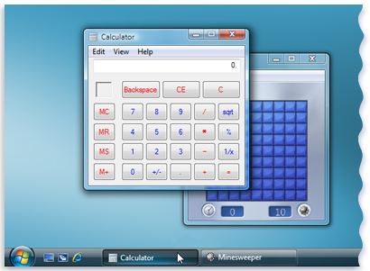
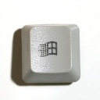
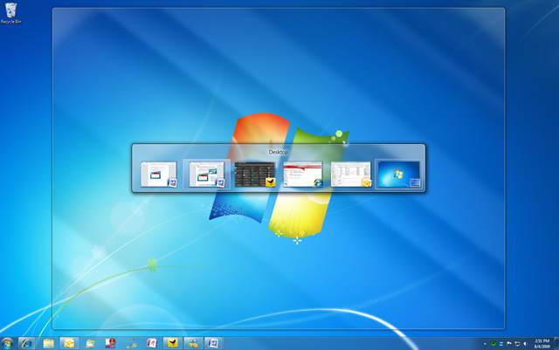
Switching Between Open Windows
When more than one window is open on the desktop, there can only be one active window.
If you want to work on another window, you must switch between windows.
  Taskbar
  Aero Flip 3D ( + tab)
  Windows Flip (alt + tab)

Slide 21
Navigating Windows
Navigate means to move from one location to another on your computer, such as switching between windows

Slide 22
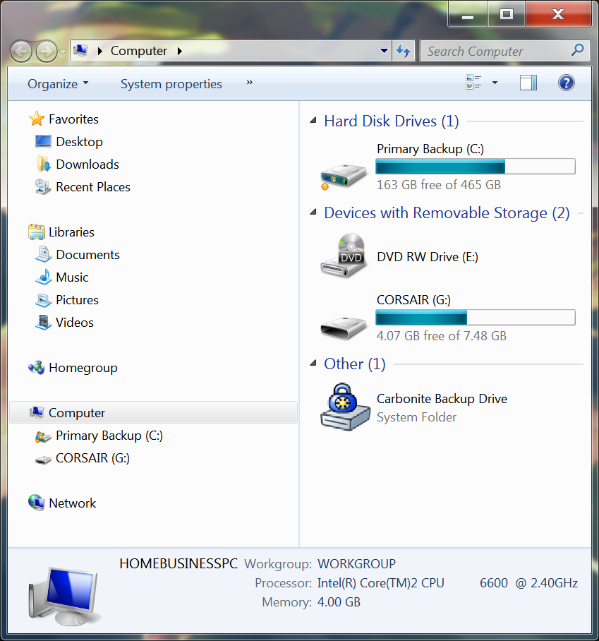
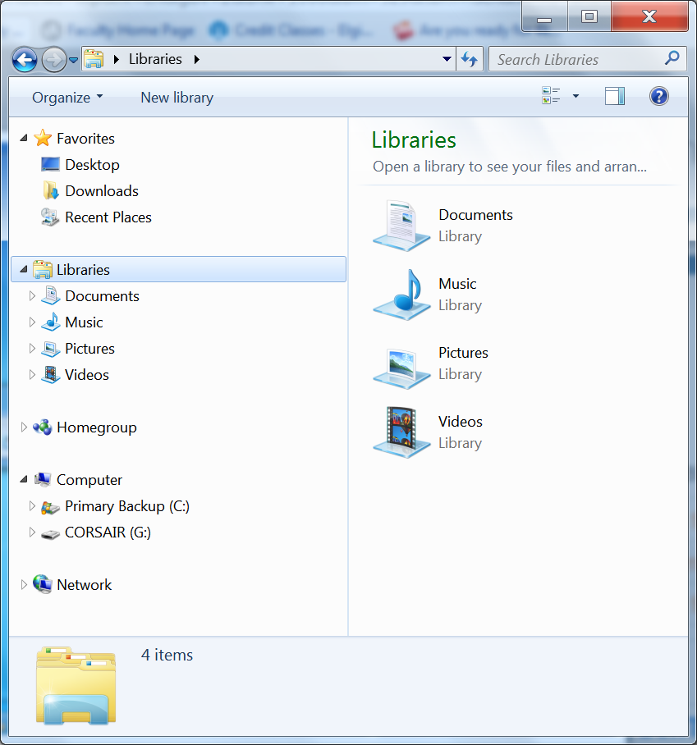
Navigating Windows
The Computer window represents your computer and its storage devices.
In Windows Explorer you are looking at the contents of the computer, a drive, or a folder.

Slide 23
Windows Explorer
Windows explorer displays;
  Each storage device you can access on your computer usually associated with a letter.
  Folder - containers that helps to organize files on a computer, just like a paper folder is used to organize files in a file cabinet.
  A library is a central place to view and organize files and folders stored anywhere that the computer can access, such as those on your hard drive, removable drives, and network.

Slide 24
Parts of Windows Explorer Window
Address bar
Search box
Navigation pane
Contents pane
Details pane

Slide 25
Navigating Windows
Topics Covered:
  Using the Navigation Pane
  Changing the View of Windows

Slide 26
Using the Navigation Pane
The navigation pane as it names implies is used to navigate between drives, folders and libraries.
The navigation process will be demonstrated in the next slide.

Slide 27
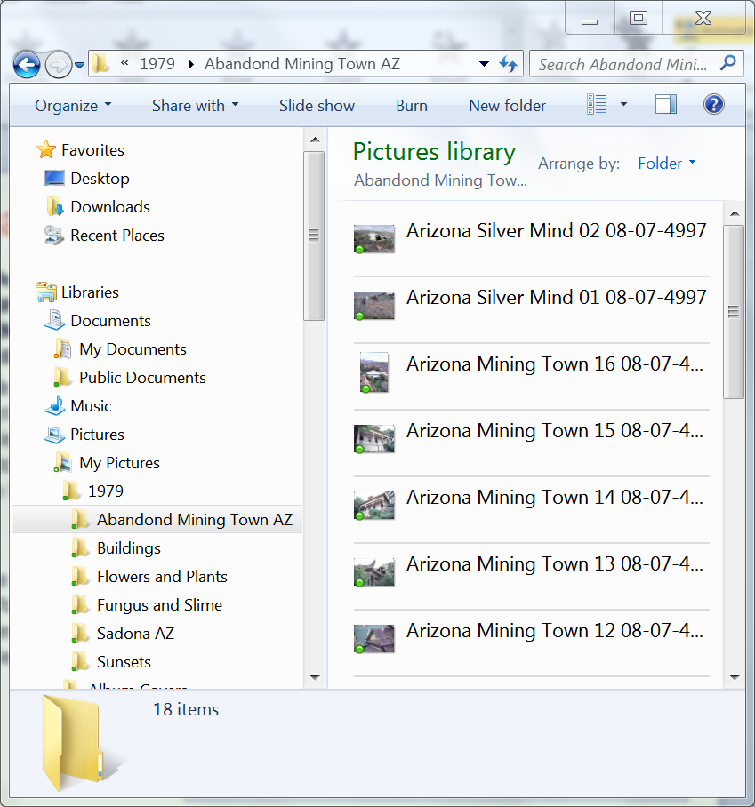
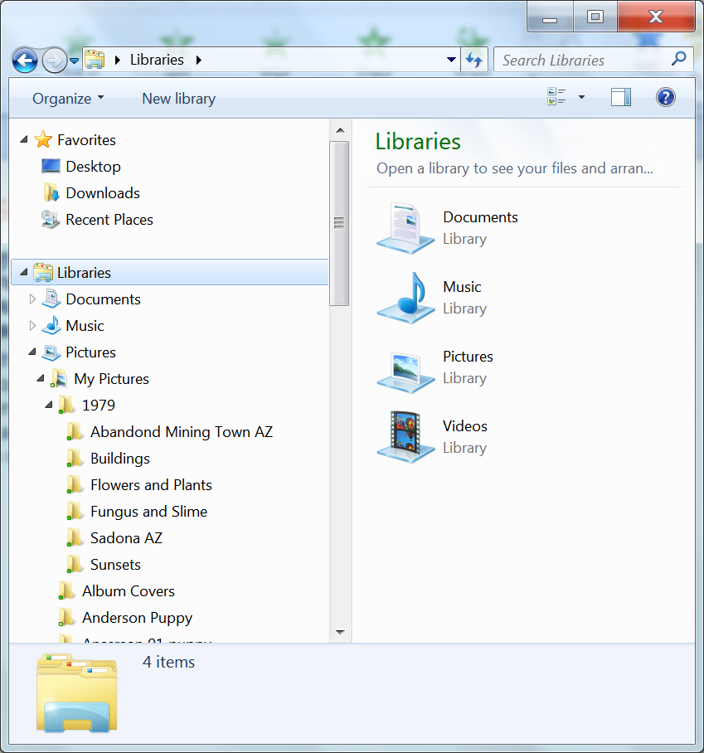
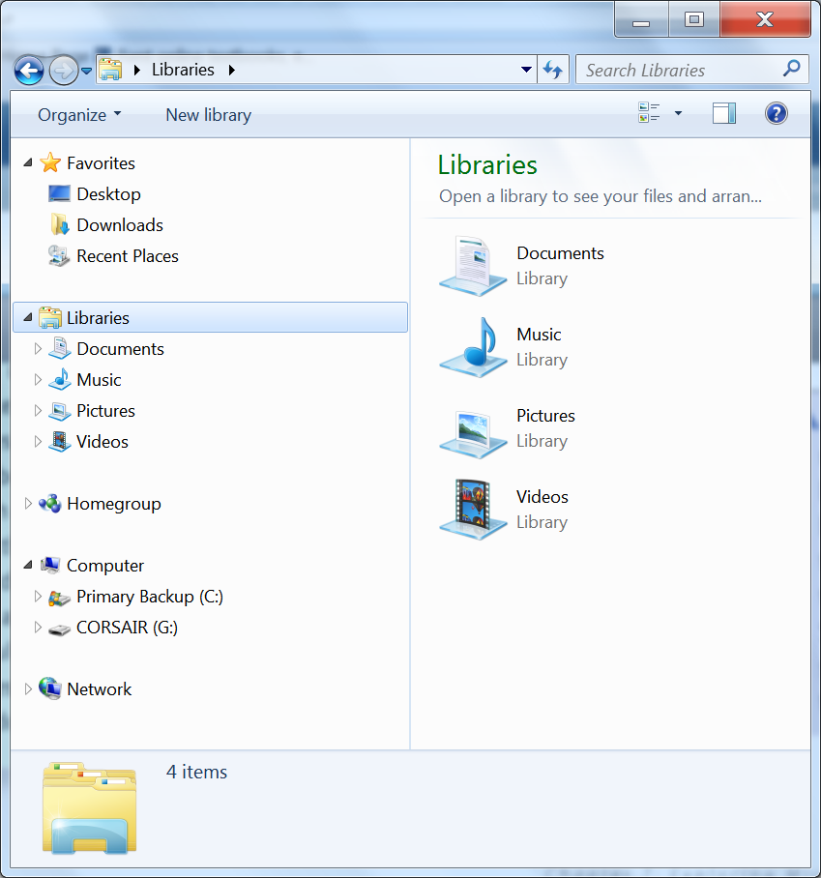
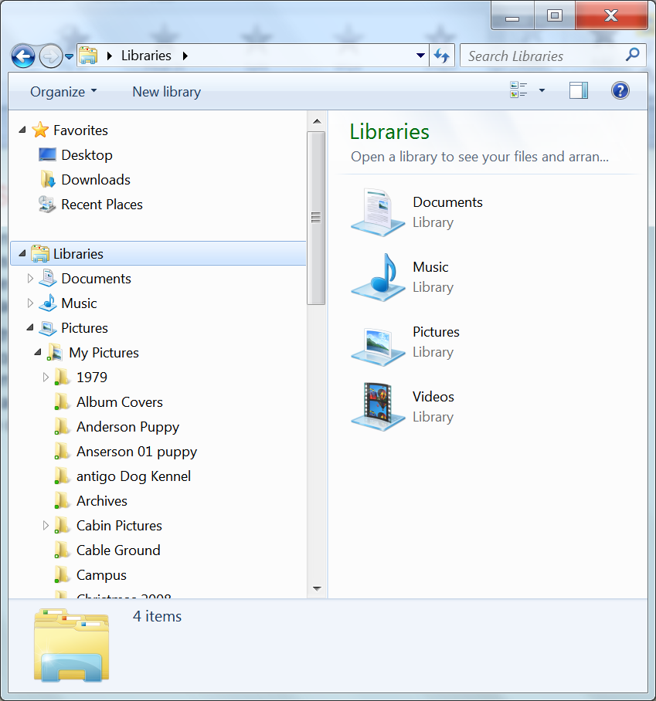
Using the Navigation Pane
Currently we are looking at what is contained in the libraries folder. Notice that the triangle is pointing down
Clicking on the triangle in front of a library or folder will open that folder and display the folders inside. (subfolders)
Note that the libraries listed have open triangles in front of them. This indicated there are additional folders inside of the library.
Note that the folders inside of the 1979 folder do not have triangles, this indicates that this folder only contains files.
Clicking on a folder with no triangle will show the files that folder contains.

Slide 28
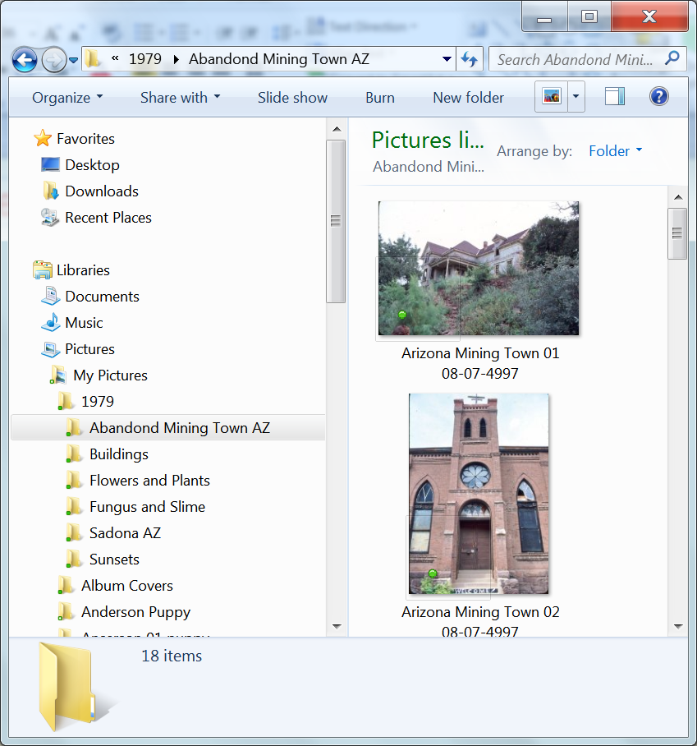
Viewing Contents of Folders.
When you click on a folder icon you see the contents of that folder.

Slide 29
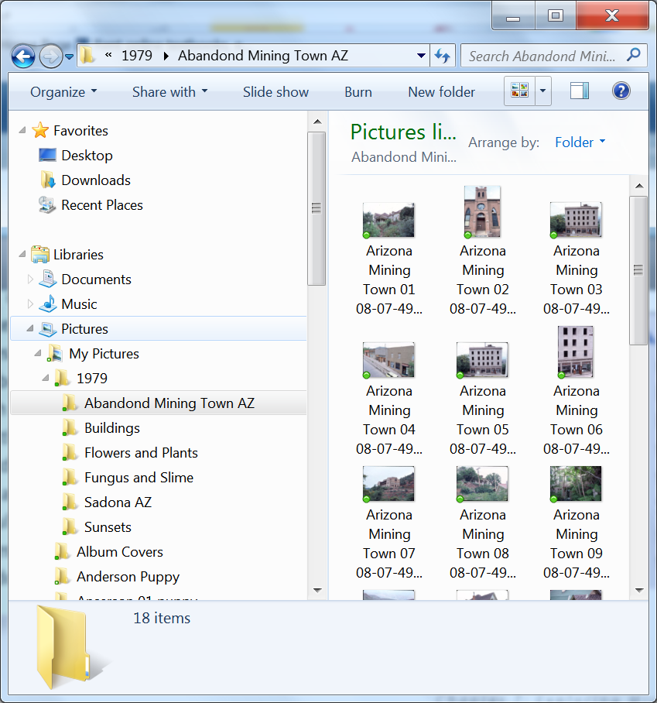
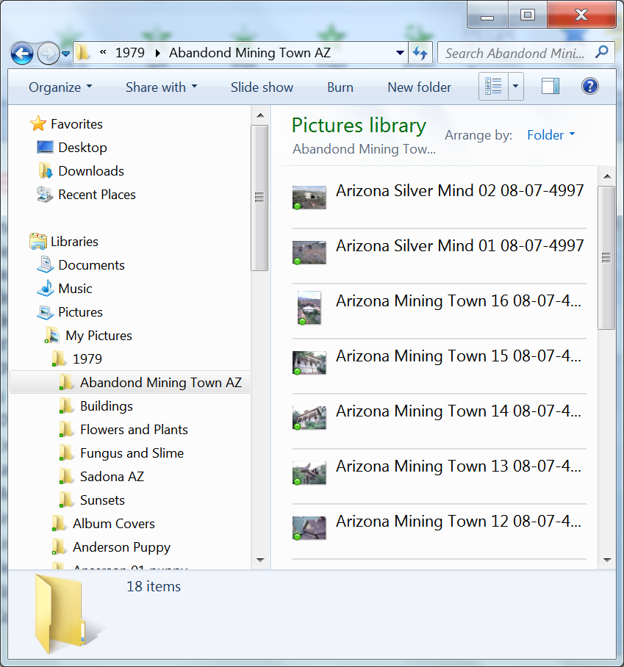
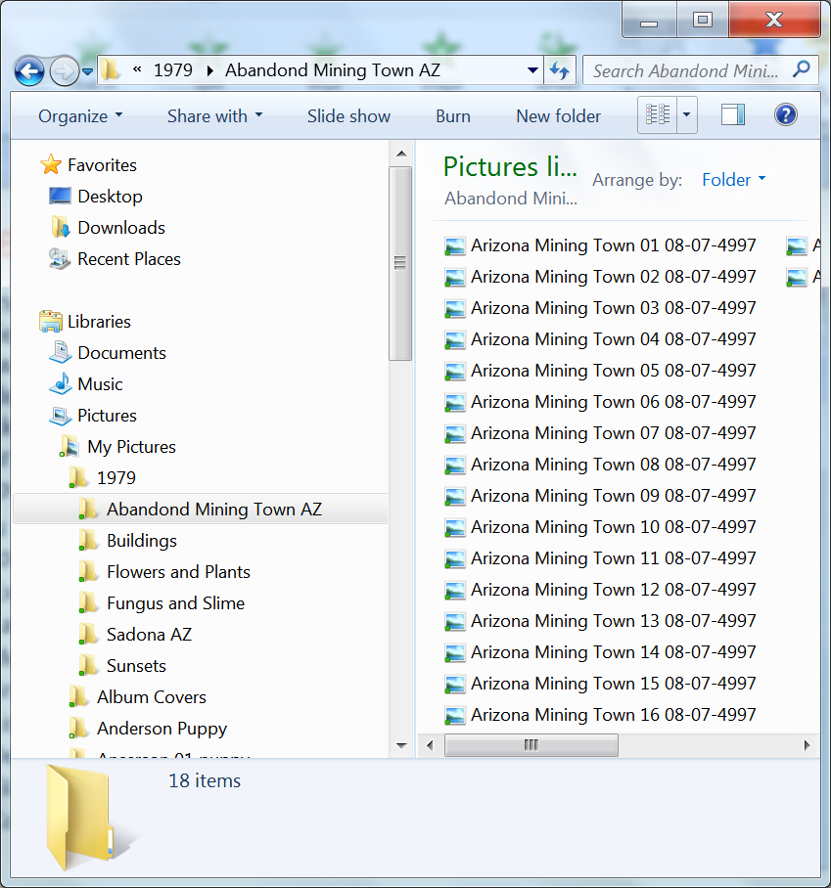
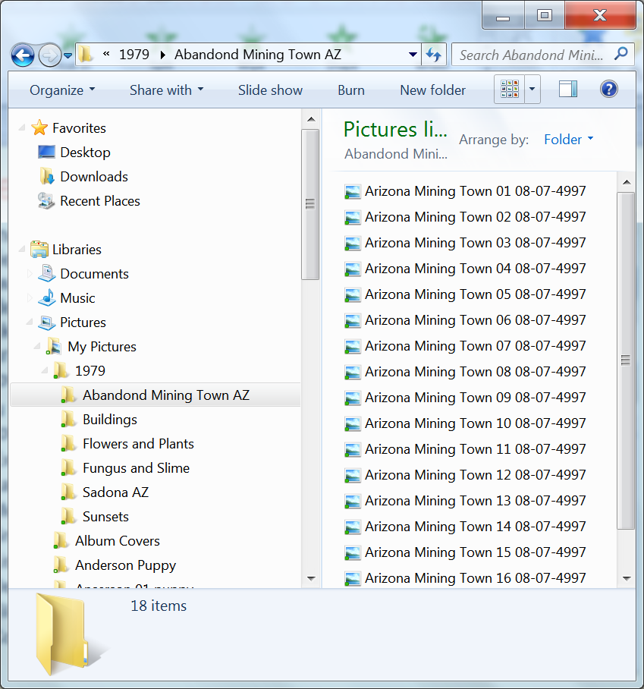
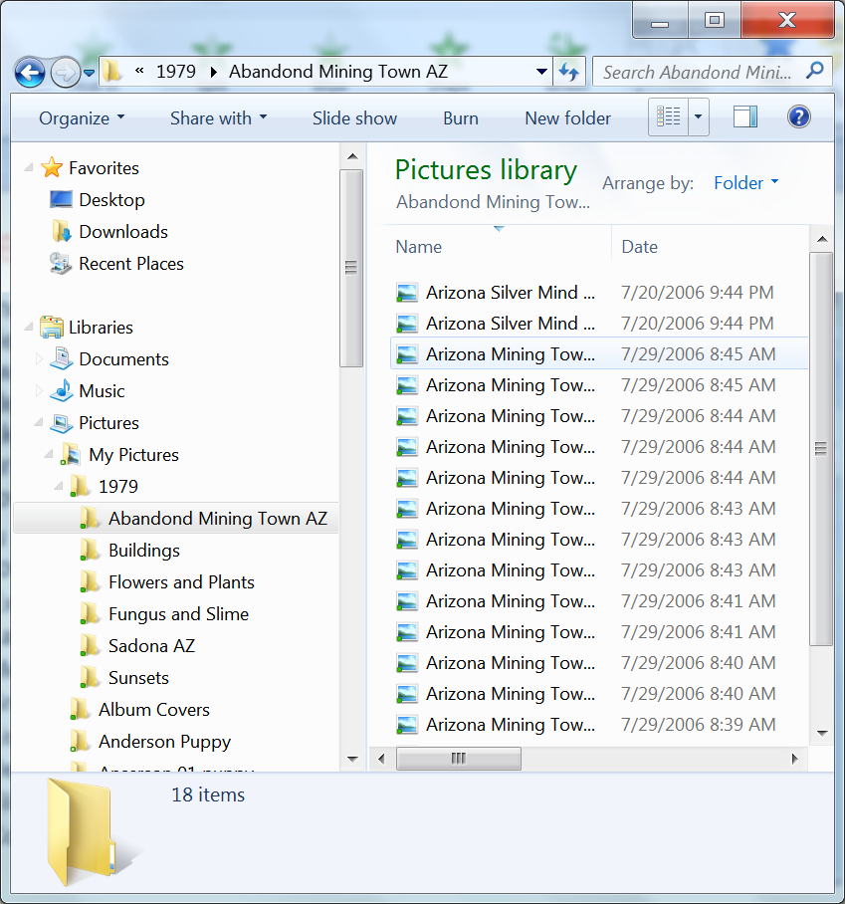
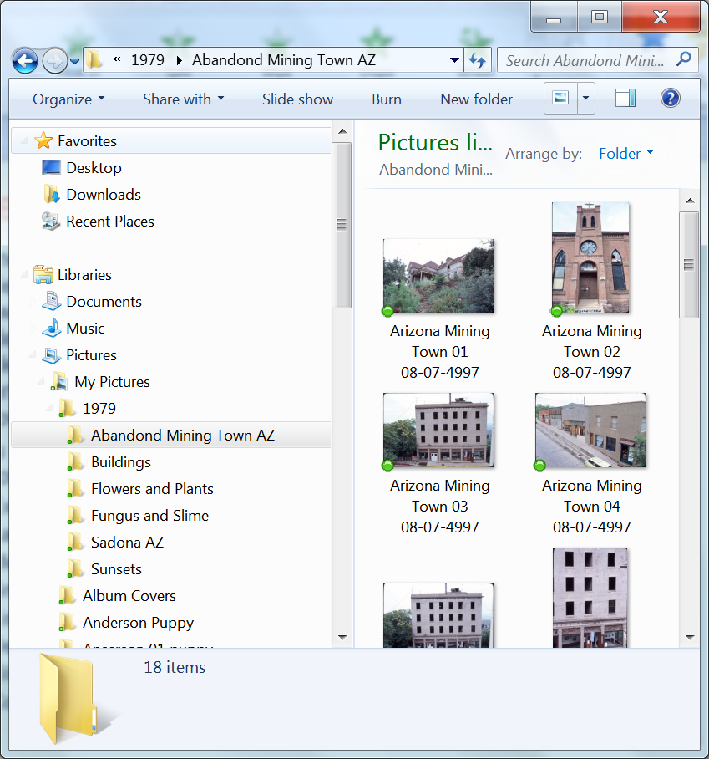
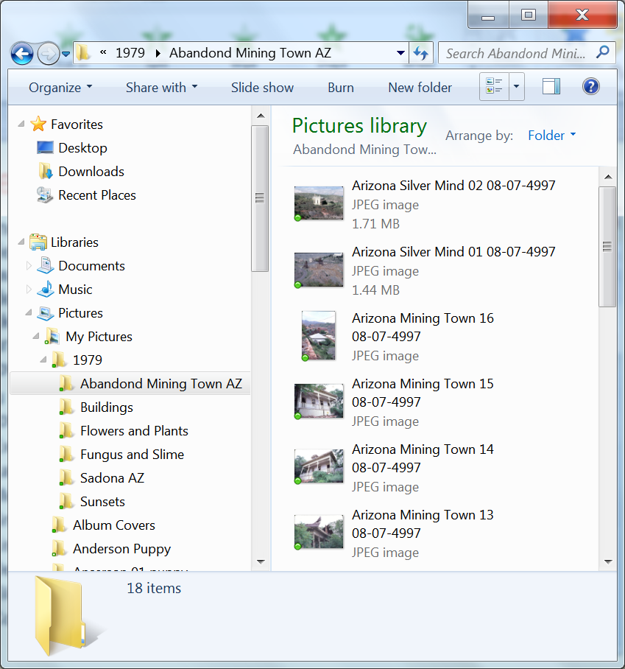
Viewing Contents of Folders.
Windows 7 provides a variety of ways to view the contents of a folder: to do this you click on the “Chang your view drop down arrow
You will see the following choices.
  Extra Large Icons
  Large Icons
  Medium Icons
  Small Icons
  List
  Details
  Tiles
  Content

Slide 30
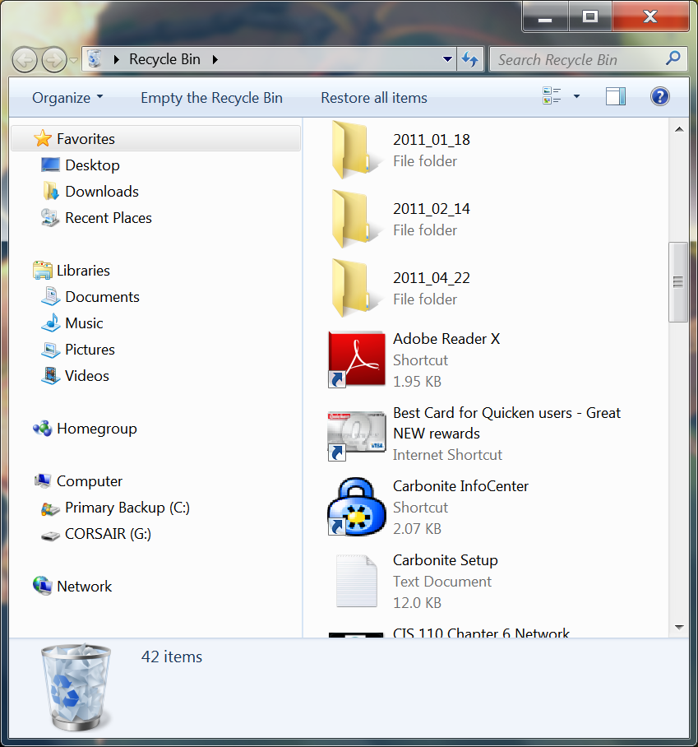
Working with the Recycle Bin
The Recycle Bin holds folders/files deleted from the hard drives on the computer until you remove them permanently.
Make it a practice to regularly empty the Recycle Bin, since storing many files in the Recycle Bin can slow down your computer’s start up time.

Slide 31
Getting Help
Topics Covered:
  Using the Contents List
  Using the Search Help Box

Slide 32
Getting Help
Windows Help and Support provides access to Help files stored on your computer as well as Help information stored on the Microsoft Web site.

Slide 33
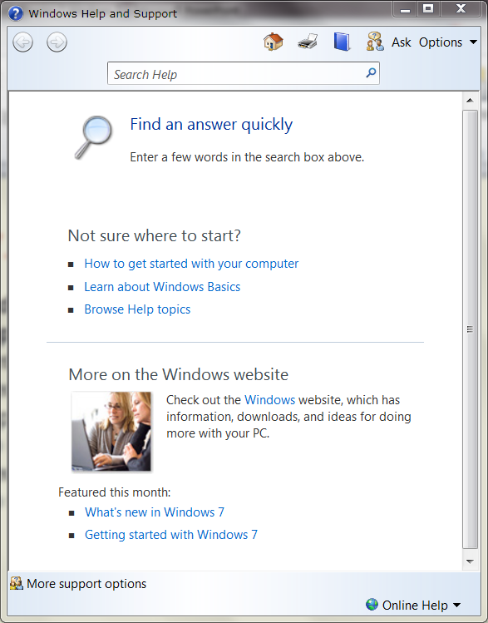
Getting Help
Search help box
Back and Forward Buttons
Tool bar
Links to basic assistance information
Link to find more information on the Microsoft Web site.
Button to switch between online and offline help

Slide 34
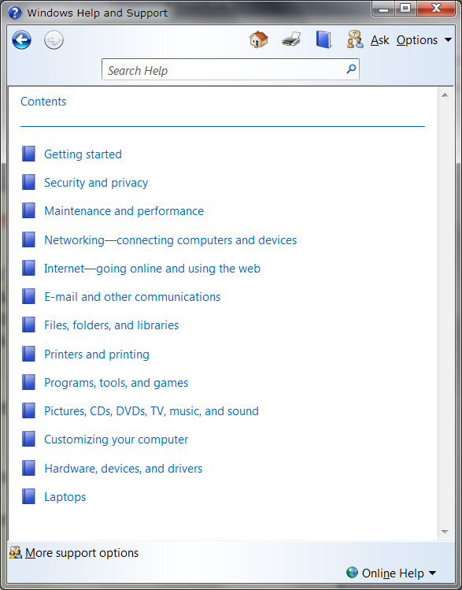
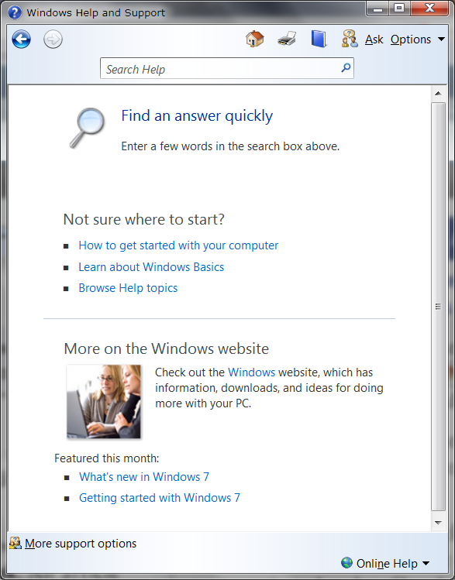
Using the Contents List
The Contents list logically organizes all of the topics in Windows Help and Support into topics and categories similar to a table of contents in a book.
To access the contents list click the Browse Help button .
When you click on this button a list of categories will appear.

Slide 35
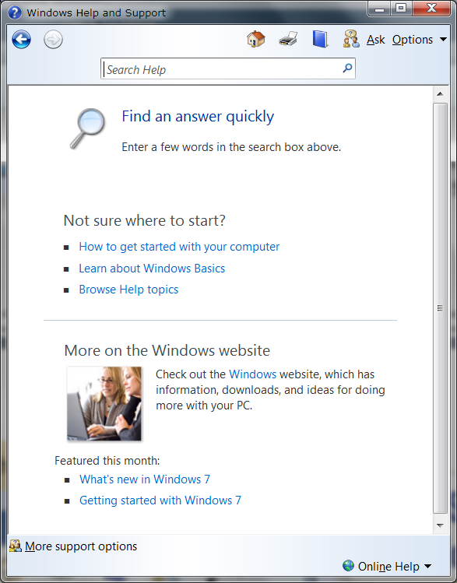
Using the Search Help Box
If you can’t find the topic you need by clicking a link or using the toolbar, or if you want to quickly find Help pages related to a particular topic, you can use the Search Help box.

Slide 36
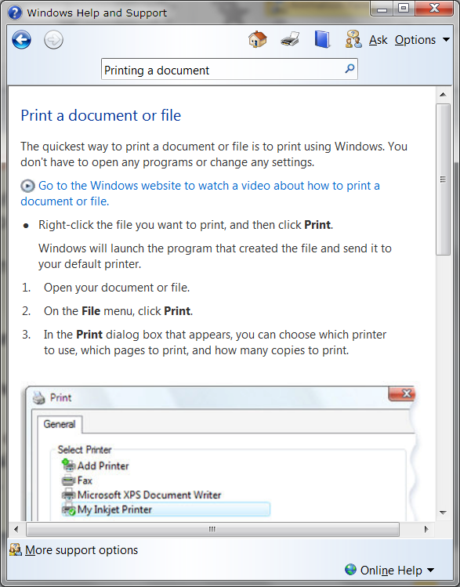

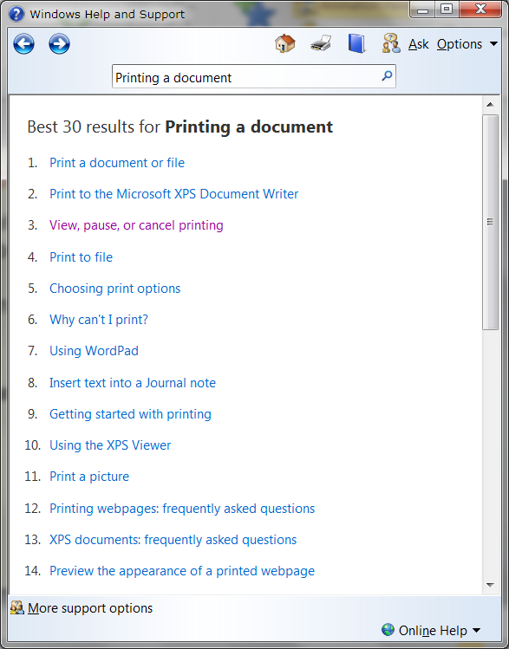
Using the Search Help Box
Enter a word or phrase about the topic you want to find information on, In this case “Printing a document.
Click on the Search help button.
A list of results will appear.
Clicking on any of the results will show the information.

Slide 37
Shutting Down Windows
You should always shut down Windows before you turn off your computer.
Switch users – bring up a screen with a list of users that can use the computer.
Log off - closes all programs and logs you off of Windows .
Lock – takes you back to the login screen
Sleep - a power-saving state that allows a computer to quickly resume full-power. Sleep puts your work and settings in memory
Hibernation puts your open documents and programs on your hard disk, and then turns off your computer

